Slide 1



Marketing
The Coldwell Banker Commercial Way

Slide 2
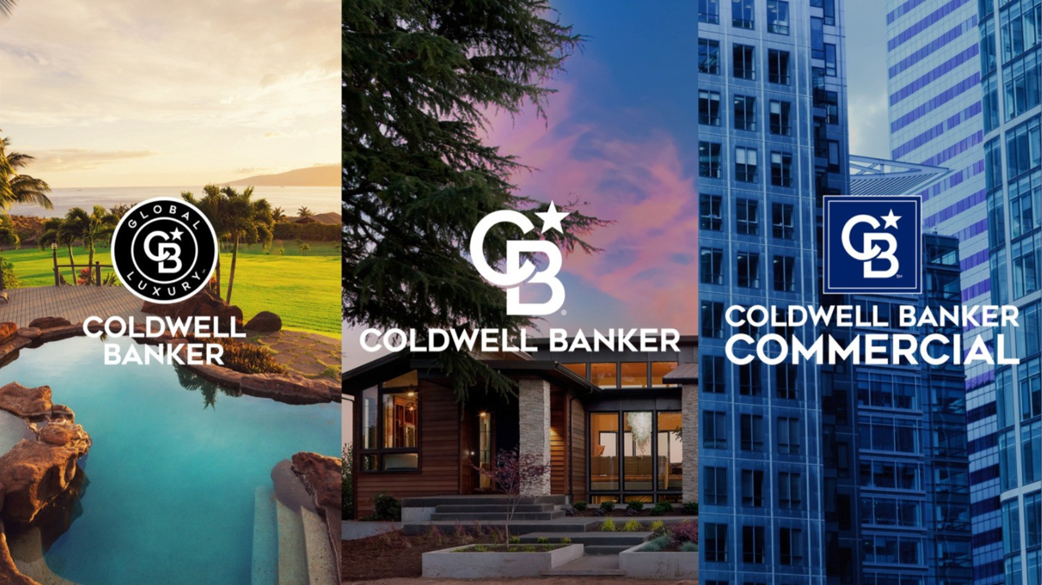

Slide 3




Brand Marketing
Branding
Advertising + Media + Social Media
Website + Analytics
Communications
Internal Communications
Public Relations + External Comms
Marketing Structure
CBC Operations
All things Coldwell Banker Commercial
Field Marketing
On the ground marketers in each affiliate or owned company

Slide 4

identity standards

Slide 5
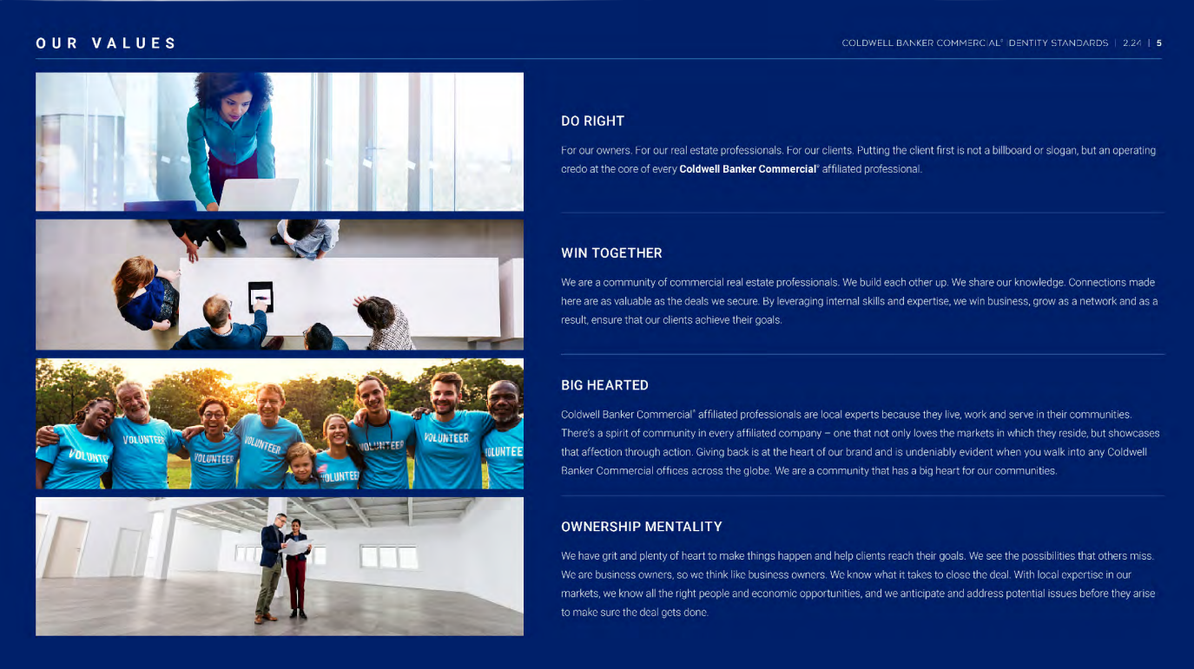
DO RIGHT
For our owners. For our real estate professionals. For our clients. Putting the client first is not a billboard or slogan, but an operating credo at the core of every Coldwell Banker Commercial affiliated professional.
WIN TOGETHER
We are a company of commercial real estate professionals. We build each other up. We share our knowledge. Connections made here are as valuable as the deals we secure. By leveraging internal skills and expertise, we win business, grow as a network and as a result, ensure that our clients achieve their goals.
BIG HEARTED
Coldwell Banker Commercial affiliated professionals are local experts because they live work and serve in their communities. There’s a spirit of community in every affiliated company - one that not only loves the markets in which they reside, but showcases that affection through action. Giving back is at the heart of our brand and is undeniably evident when you walk into any Coldwell Banker Commercial office around the globe. We are a company that has a big heart for our communities.
OWNERSHIP MENTALITY
We have grit and plenty of heart to make things happen and help clients reach their goals. We see the possibilities that others miss. We are business owners, so we think like business owners. We know what it takes to close the deal. With local expertise in our markets, we know all the right people and economic opportunities, and we anticipate and address potential issues before they arise to make sure the deal gets done.

Slide 6
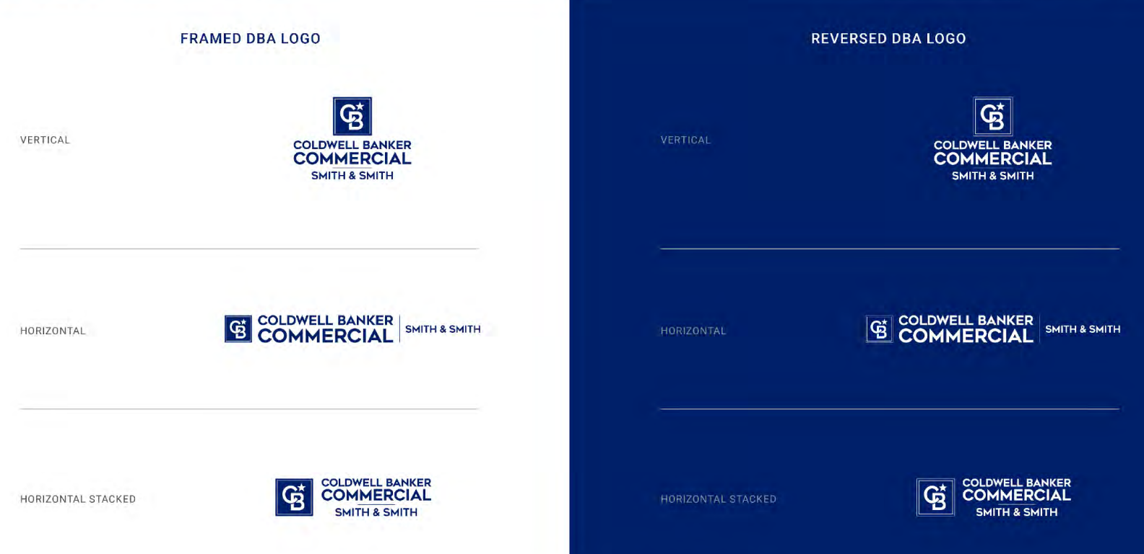

Slide 7





the right
angle
Branding
Identity Standards
Brand Building Blocks (logo usage, colors, fonts, imagery, etc.)
Office Signage
Property Signage
Digital Guidelines
Logo Compliance
When in doubt, share a proof!
INFORMED
POLISHED
PROFESSIONAL
Our
values
DO RIGHT
WIN TOGETHER
BIG HEARTED
OWNERSHIP MENTALITY
Primary
color
Coldwell banker
commercial blue

Slide 8
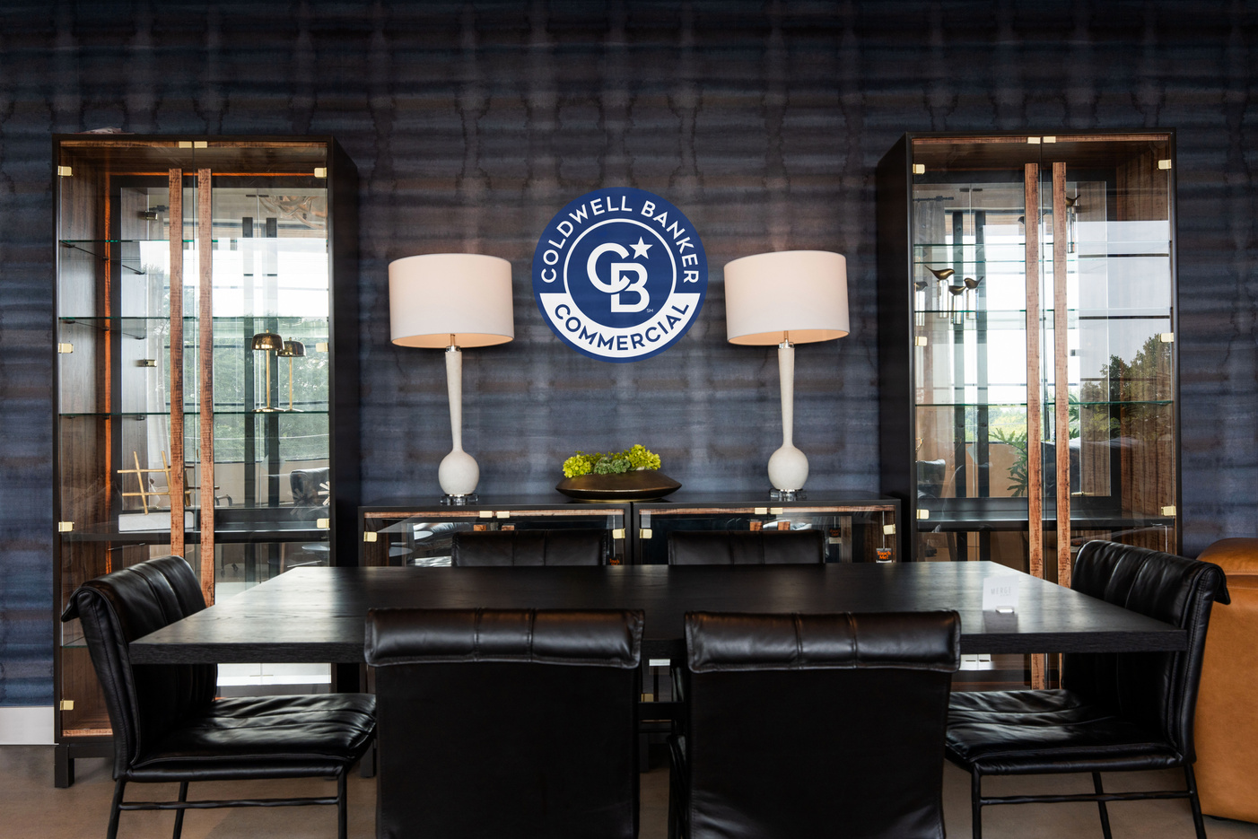
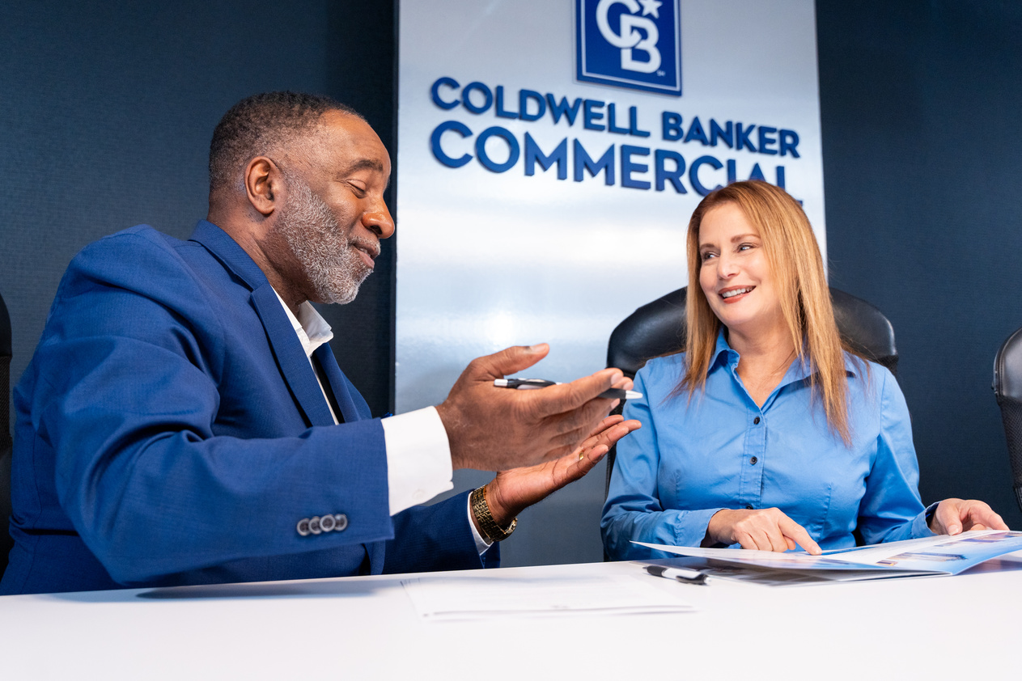
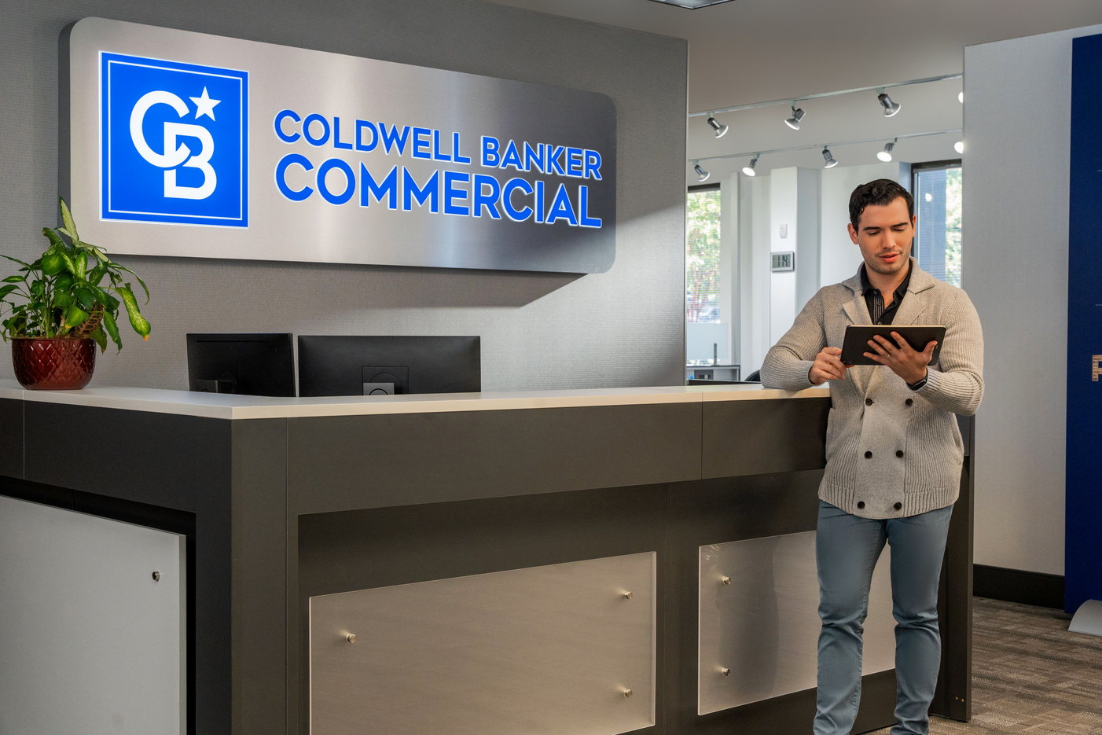

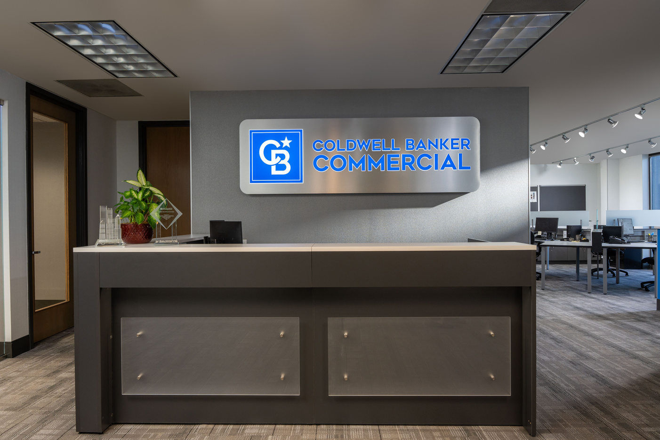

CBC Photography

Slide 9

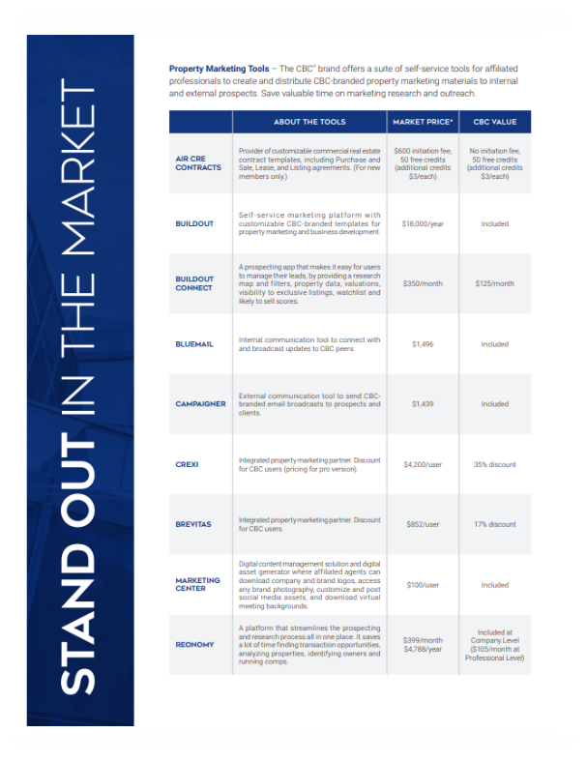
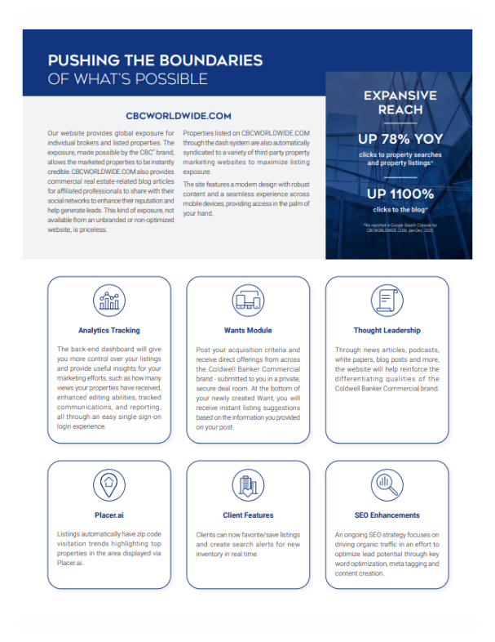
Platform of value

Slide 10
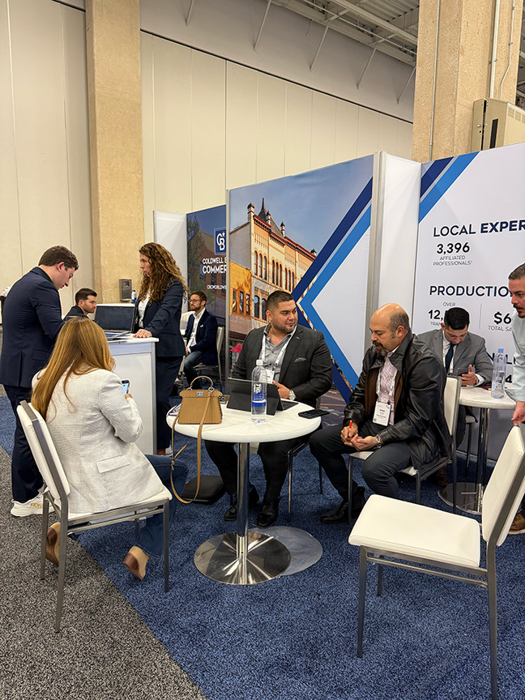
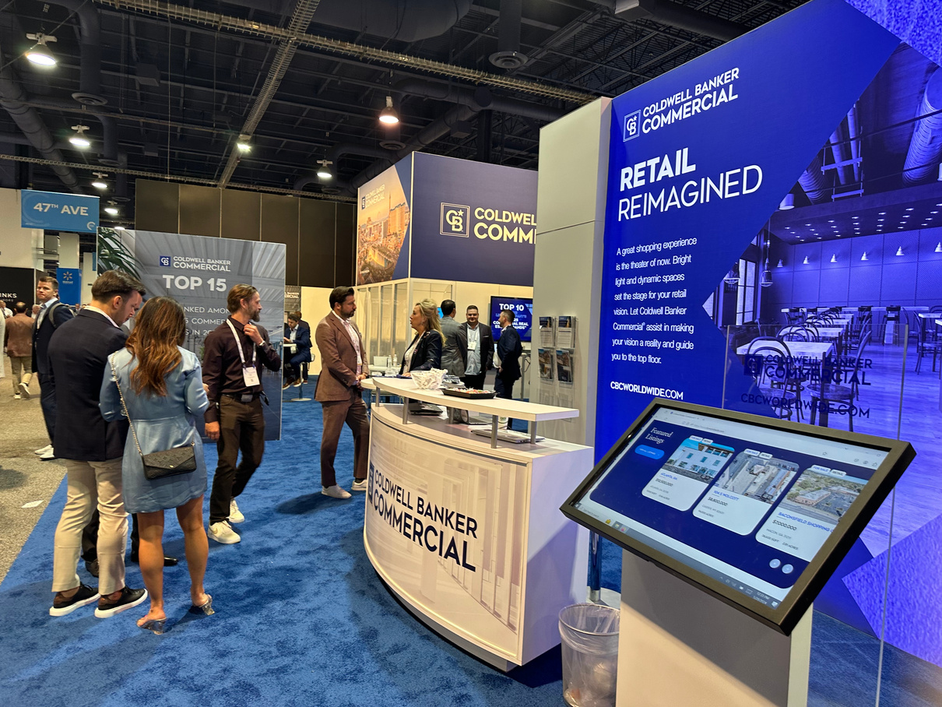
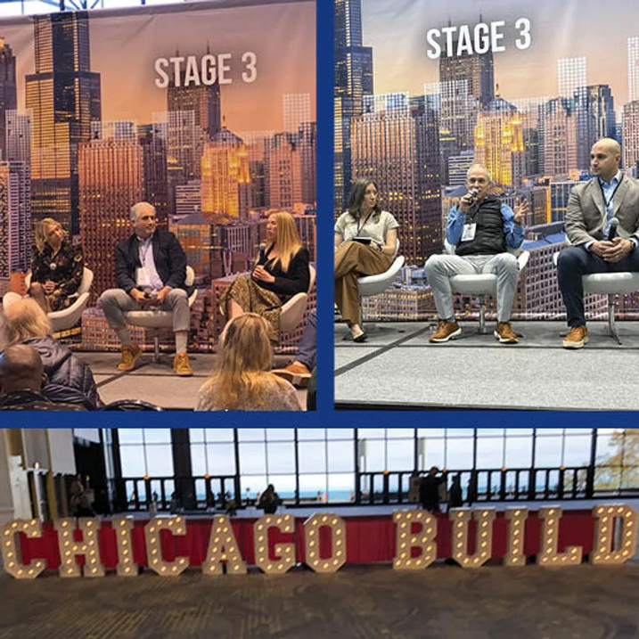
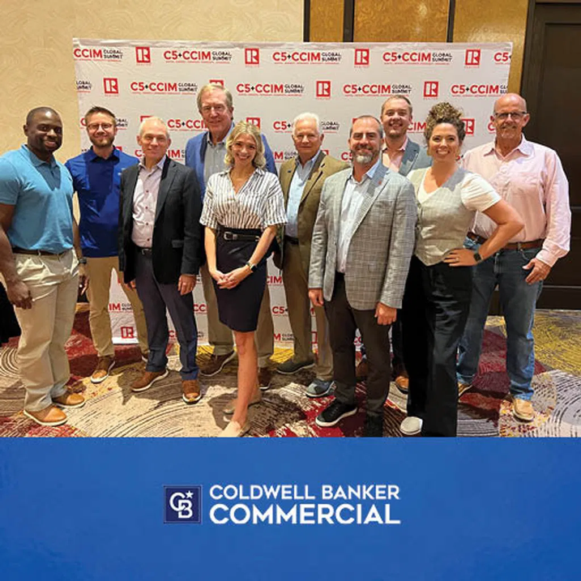
INDUSTRY EVENTS
ICSC Red River
SIOR Spring Meeting
ICSC Las Vegas
NAR C5 + CCIM Global Summit
SIOR Fall Event
BUILD Chicago
ICSC New York

Slide 11
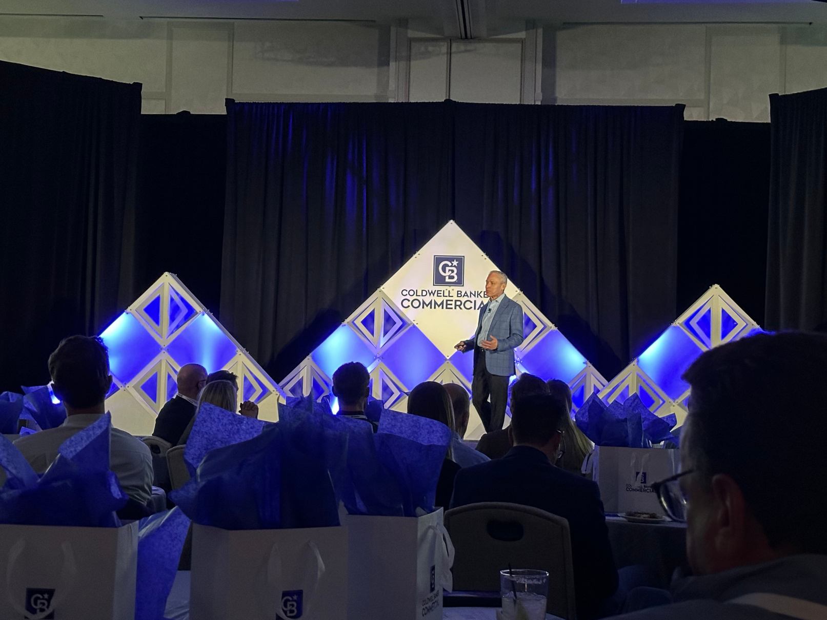
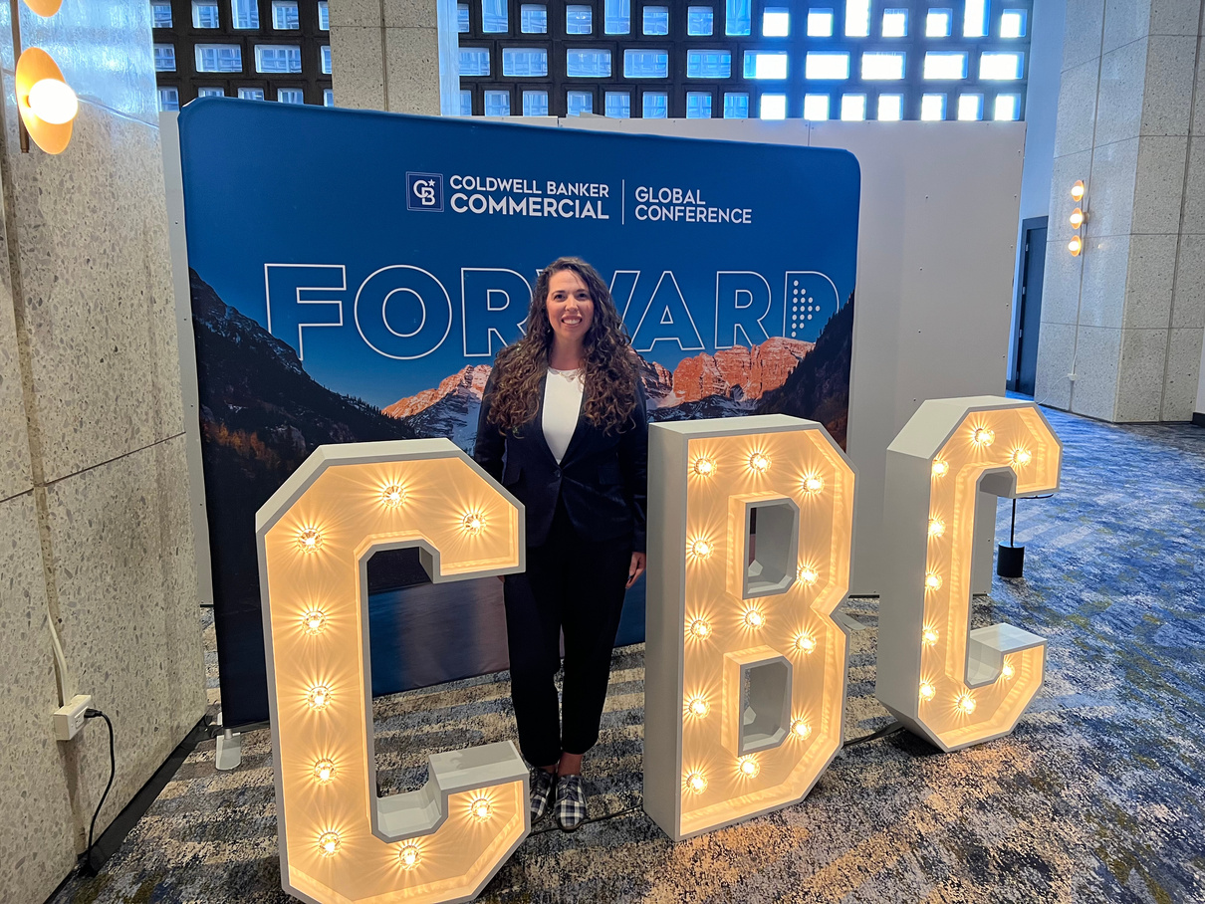
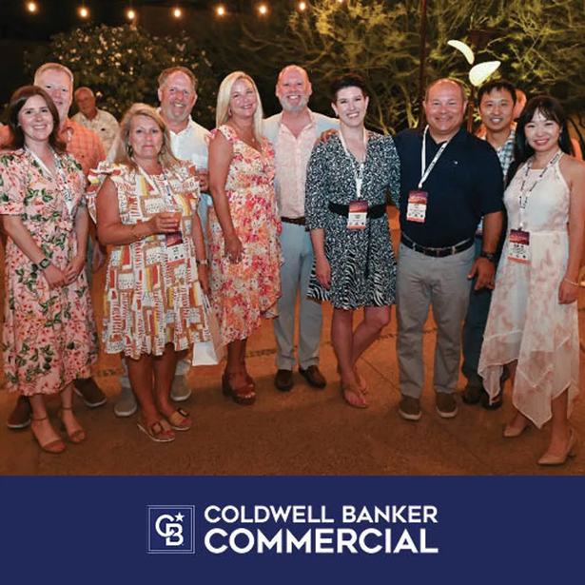
BRAND EVENTS
Global Conference
Elite/Top 2
Virtual Fall Summit
Virtual Quarterly Marketing Meetups

Slide 12
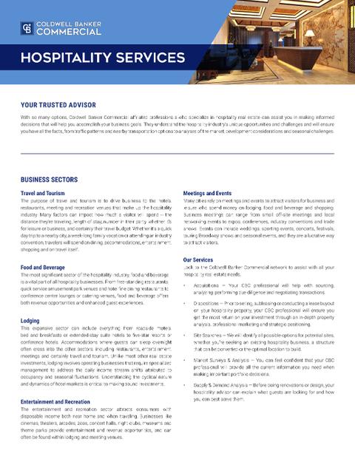
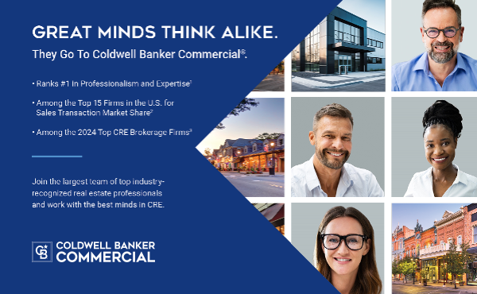
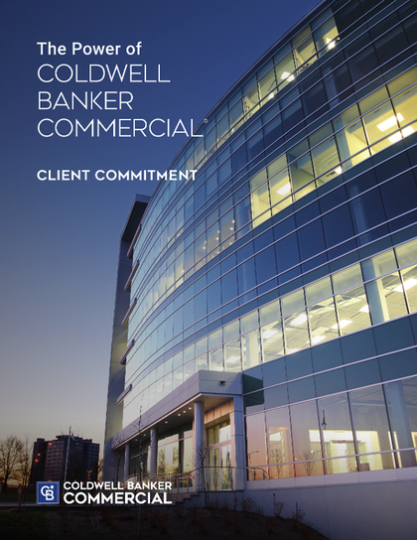
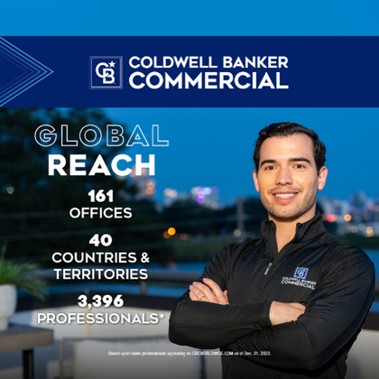
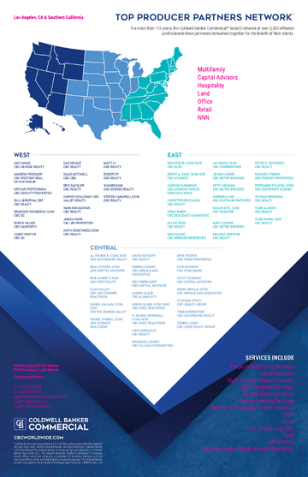
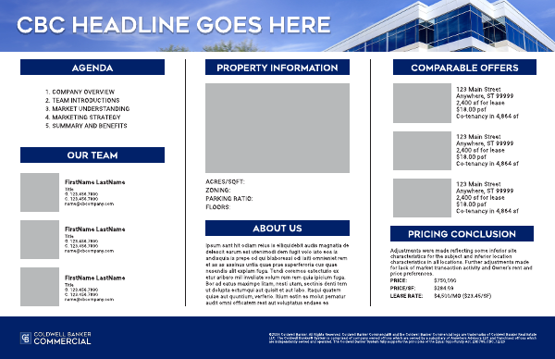
Your marketing
CUSTOM BRAND CONTENT MADE SIMPLE
Digital + Print Listing Marketing
Recruiting Campaigns
Email Marketing Assets
Social Media Content
Dynamic Presentation Templates
Company/Office/Agent Branding
WHAT’S IN IT FOR ME?
Reduces lift of "marketing from scratch"
Integration with technology suite makes marketing automation easier
All included at no additional cost

Slide 13
public relations
Crises Management
Advice
Provide templates & media lists
Offer listing support
Reputation management
We get you into the news or keep you out it!

Slide 14
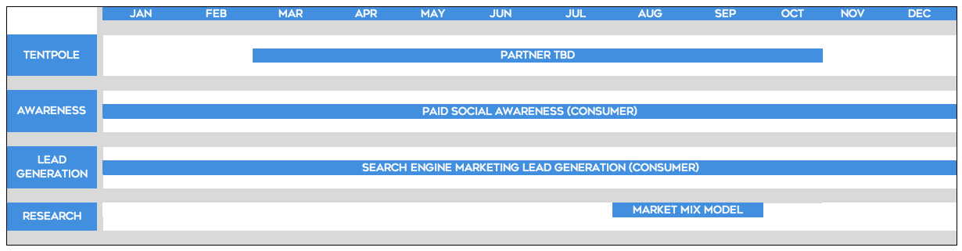




2025 US media approach*
*Media plan subject to change.
TBD
Exploring potential partners for a tentpole awareness media activation
Looking to reach clients on a national scale with a targeted focus in top regional markets for the CBC brand.
More details to come!
Continue our successful paid social campaigns to drive awareness of the CBC brand on Facebook, Instagram and LinkedIn while driving traffic to CBCWW.com.
Continue driving efficiencies from 2024 learnings.
Conversion-based campaigns with dynamic search campaigns on Google.
Drive leads to CB companies via CBCWW.com.
Continue driving efficiencies from 2024 learnings.

Slide 15
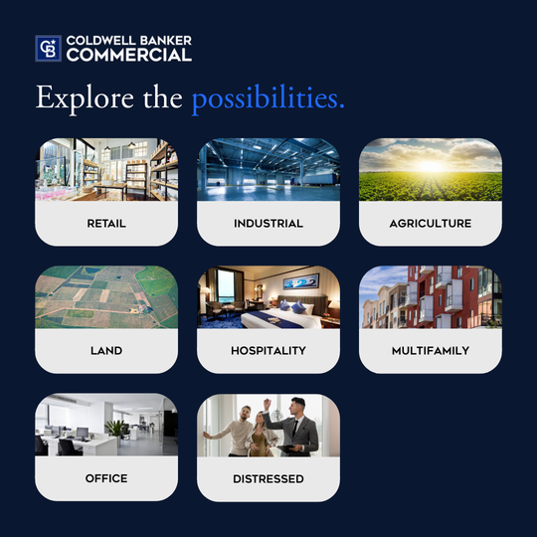
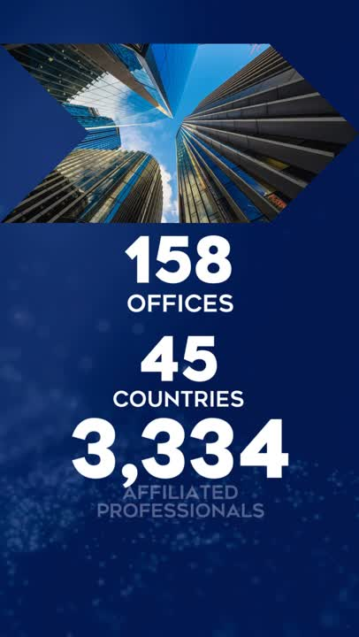
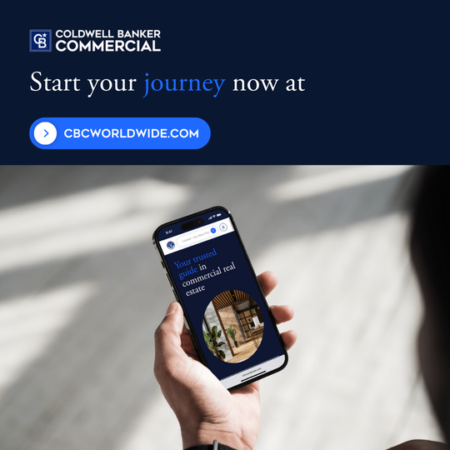

cbcworldwide.com
Jan-May US Media Performance
THROUGH MAY, AGGREGATED MEDIA PERFORMANCE IS AT A 148-INDEX TO BENCHMARK
EXCELLENT SEM RESULTS
Received 22k+ clicks to CBCWW.com
Generated an average CPL of $50
114-index to benchmark
Strong Social performance
Generated 1.3M+ impressions
Received 50k clicks to CBCWW.com
With an average CTR of 3%.
Meta + LinkedIn campaigns are seeing 174-index to benchmarks.

Slide 16

2025
US Social Strategy

Slide 17
2025 US Social Strategy
Create memorable and shareable storytelling focused on engagement.
Highlight the people and knowledge of CBC.
Celebrate the success and growth of our network.
Showcase our events and industry involvement.
Notes:
Based off our successes and learnings from 2024 we've developed a proposed social strategy for 2025.
Four key elements

Slide 18
Content Pillars
Growth | Expertise | Community
Network growth and mergers | Report content | Global Conference
Network success stories | Industry news & analysis | Industry event engagement
Most interesting listings | Podcast clips
 | Leadership videos

Slide 19
Core Metrics
ENGAGEMENTS
PER POST
Content
Effectiveness
IMPRESSIONS
Brand Awareness
ENGAGEMENTS
Brand Affinity

Slide 20
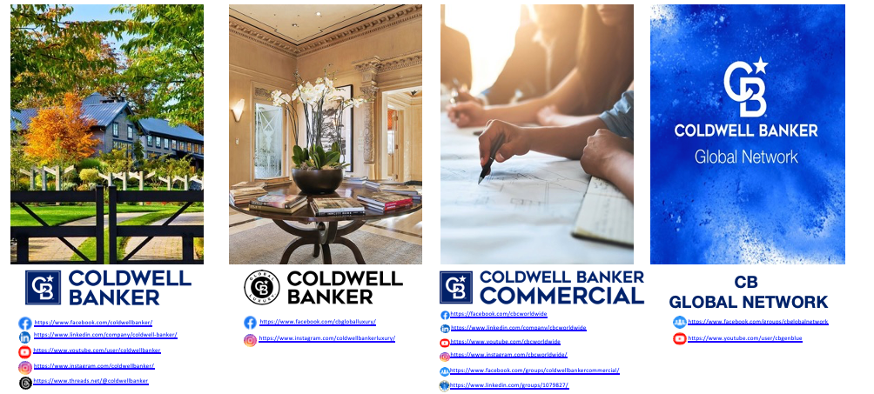
cbC on social media

Slide 21

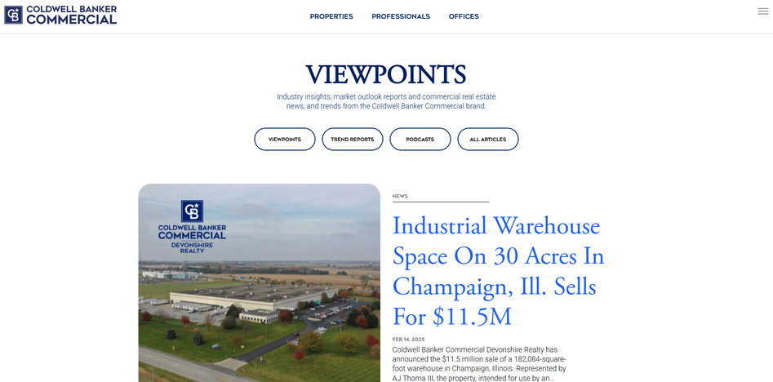
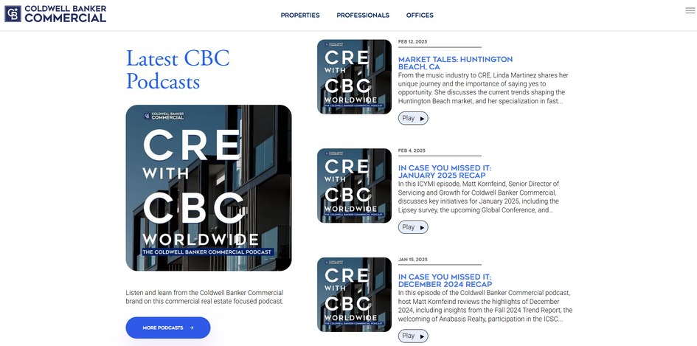
thought leadership
Use the Viewpoints blog and the CRE With CBC Worldwide podcast to help populate your social media channels or your own blog with content
CBCWorldWide.com/blog
News
Podcasts
Insights
Trends
Trend Reports & Outlook Reports

Slide 22





branded gif stickers
SEARCH: #CBCworldwide on Giphy.com under “stickers”

Slide 23
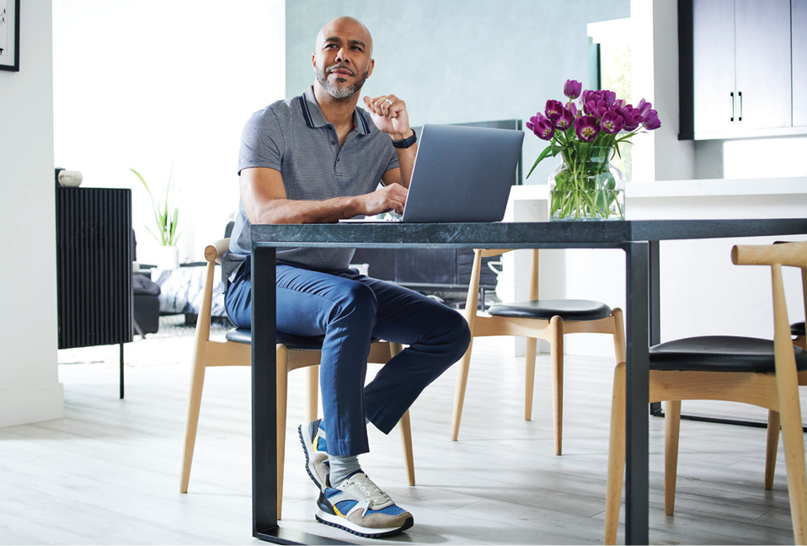
THANK YOU

Slide 24
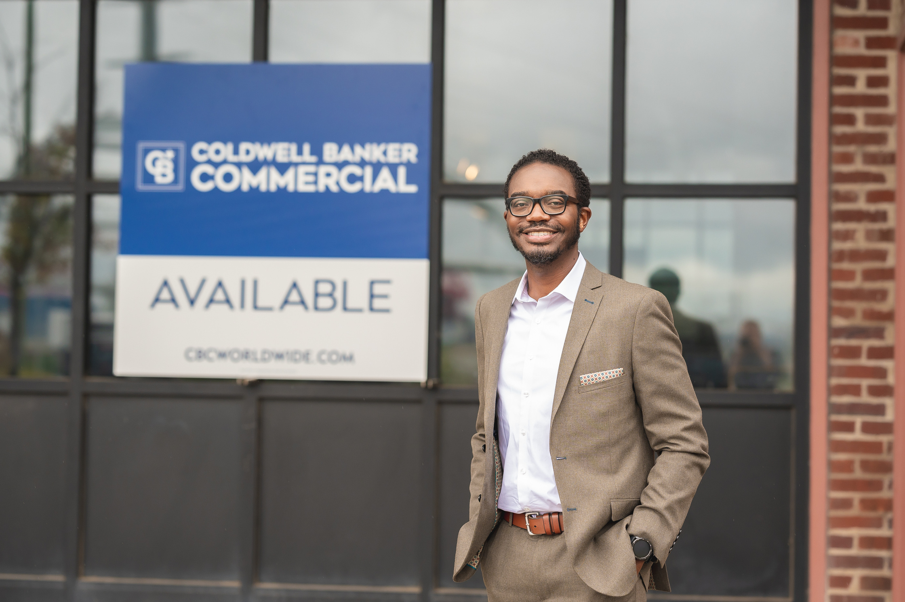
appendix

Slide 25




TOP RECOMMENDATIONS
CELEBRATE YOUR TEAM
INCORPORATE A PAID APPROACH
Organic reach is essentially dead.
Use paid campaigns to reach your target audience with your company value proposition!
Highlight wins from your team
and company milestones.
Tag users to help spread the word!
EXPERIMENT WITH AI
CONTENT VARIETY
Work smarter, not harder!
Use AI tools to craft copy, create imagery and build plans to make your social media easier
Sharing a variety of content is key to reach + engage users!
Reels, carousels, stories

Slide 26

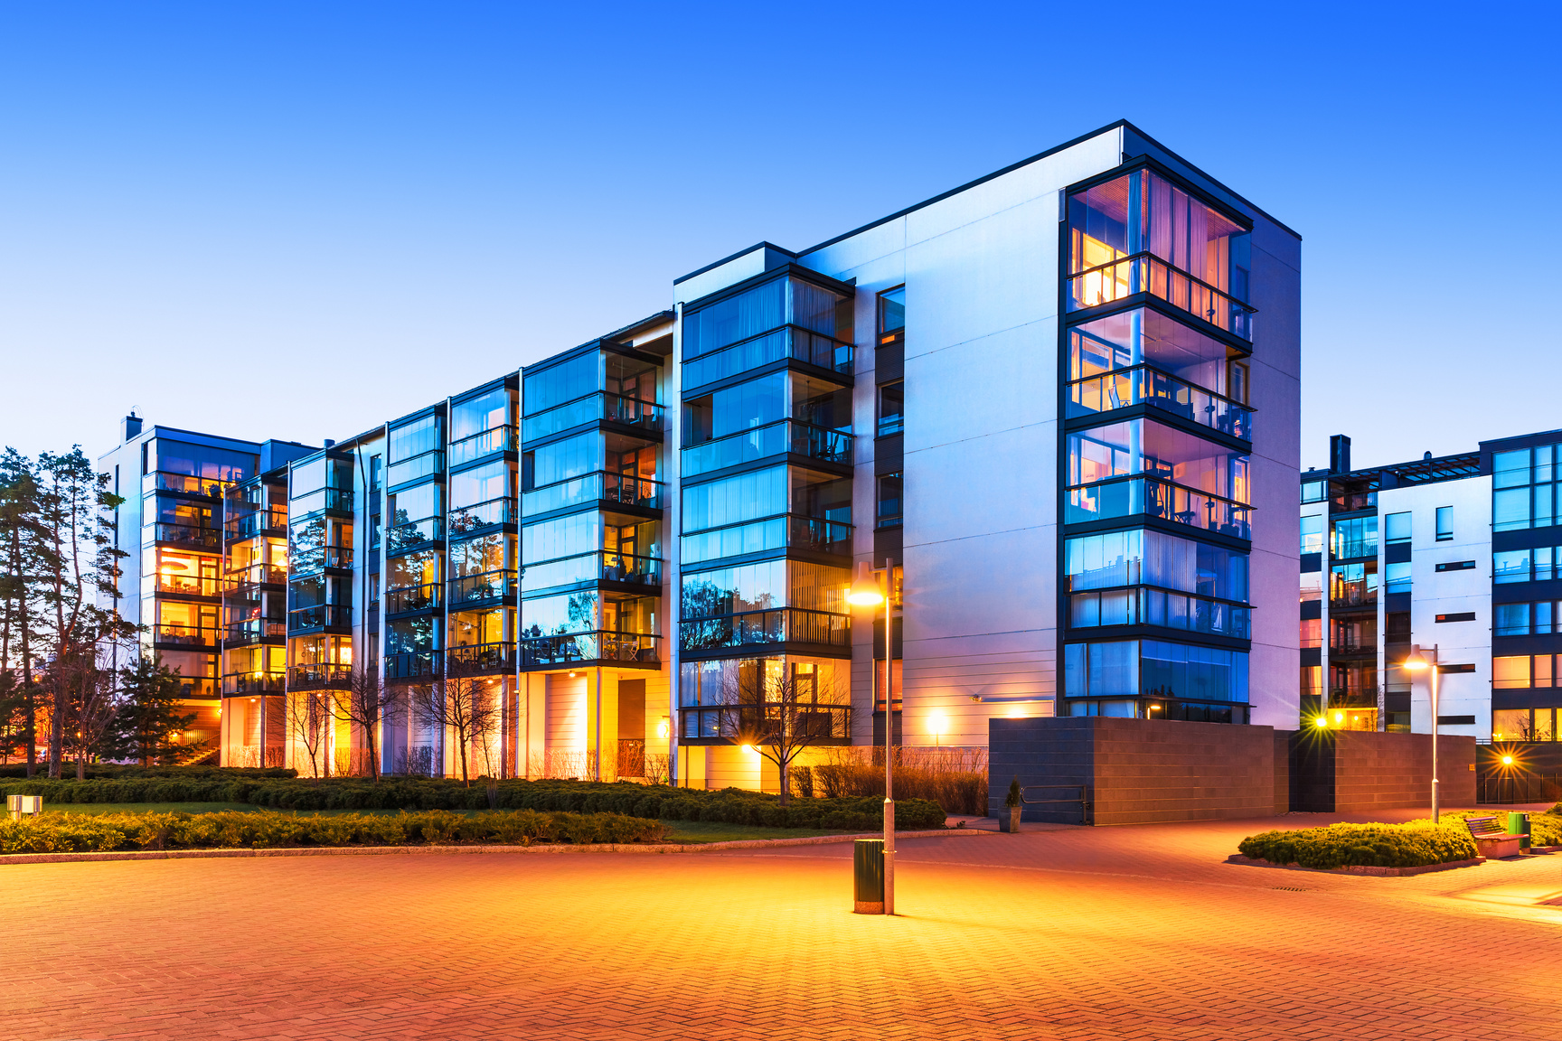

Facebook
Best Practices
Content should be shared 1-2 a day MAX.
3-5 times a week to keep a regular schedule.
Posts should have unique look and feel. Do not repeat. Keep the creative different.
Copy should be short and sweet! Make it enticing so users click to your site.
Be sure to use of links when promoting your listings!
Highlight your professional’s achievements and promote your team.
Share your professional’s post from their Facebook pages.
Upload video content that keeps users engaged.
If not engaged, most users drop off within the first 3-5 seconds.
Use insights + analytics to track your results! Be informed on what content performing and what’s not.
Learn more: https://www.facebook.com/business/news/tags/best-practices

Slide 27

Instagram Best Practices
Post to the newsfeed 1-2 times a day MAX.
Use IG stories to post more often + topical updates.
Try Instagram Stories as a way to give BTS look at the properties for sale.
Play around with stickers, gifs, polls, + link out to listing pages.
Focus on creating Reels content as it’s the best performing on this platform.
Always use high quality content!
Blurry, lo-res, sub quality content will not perform well.
Experiment with different post types for the platform.
Carousel | Vertical photos | Boomerangs | Time lapses
Use the location feature on featured properties.
Learn more: https://business.instagram.com/blog/

Slide 28



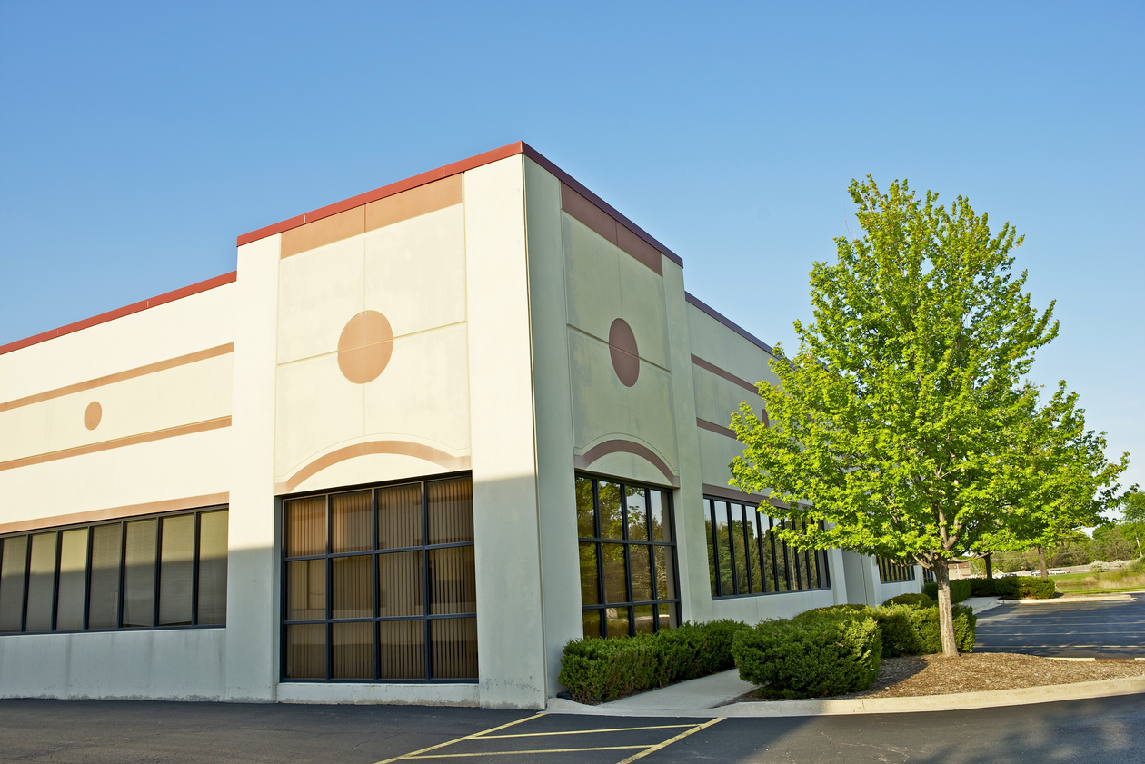
LinkedIn
Best Practices
Make sure you’re using a company page or have your personal accounts public so users can follow your updates.
Complete your profile with a cover photo and contact info.
Content should be shared 1-2 a day MAX.
2-4 times a week to keep a regular schedule.
Posts should have a unique look and feel. Do not repeat. Keep the creative different.
Copy should be short and sweet! Make it enticing so users click to your site.
Remember to tag relevant people or businesses to expand your reach.
Use insights + analytics to track your results! Be informed on what content performing and what’s not.
Learn more: https://business.linkedin.com/marketing-solutions/company-pages/best-practices

Slide 29
YouTube Best Practices
Experiment with different video lengths. See what works best for you.
:15s | :30s | :60s | 2min | 4min+
Make sure your videos are high quality (minimum 720p.) No one wants to watch a blurry or low-quality video!
Use engaging thumbnails + titles. These give users the first look of your video as they’re browsing the platform.
Add a branding watermark to videos to drive recognition of your brand image on all your videos + gives a way for users to easily subscribe to your channel.
End screens provide the opportunity to promote other videos, link back to your website and more so users stay engaged with your content longer after a video has ended.
Add cards to videos to add interactivity. You can link back to a specific listing and have it show up at certain times of a video on desktop or mobile.
To do this, you need to link your website to your YouTube Account.
Optimize your videos! Use relevant tags and descriptions to better help your search findability.
Organize your channel homepage + create playlists of similar content to group videos together.
Try out YouTube TrueView! It’s practically free advertising for your content!
Learn more: https://support.google.com/youtube/?hl=en#topic=9257610

